Slide 1

Bignum Calculator
by Joseph Pollack

Slide 2

library repo:
github.com/eindacor/JEPbignum
calculator repo:
github.com/eindacor/JEPbignum_calculator
library docs:
github.com/eindacor/JEPbignum/blob/master/README.md

Slide 3

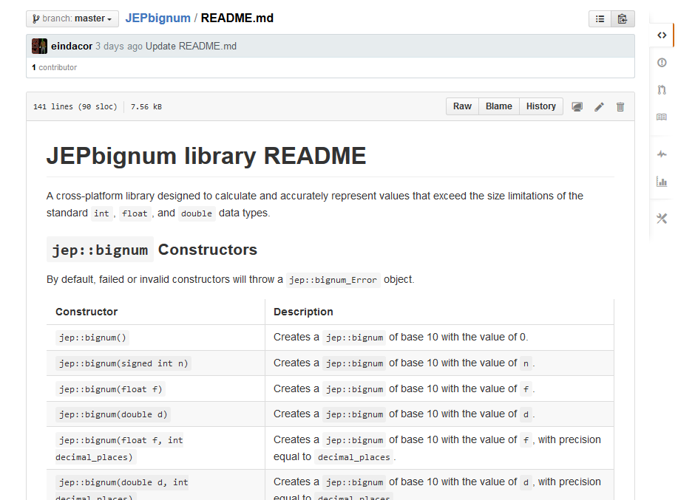

Slide 4

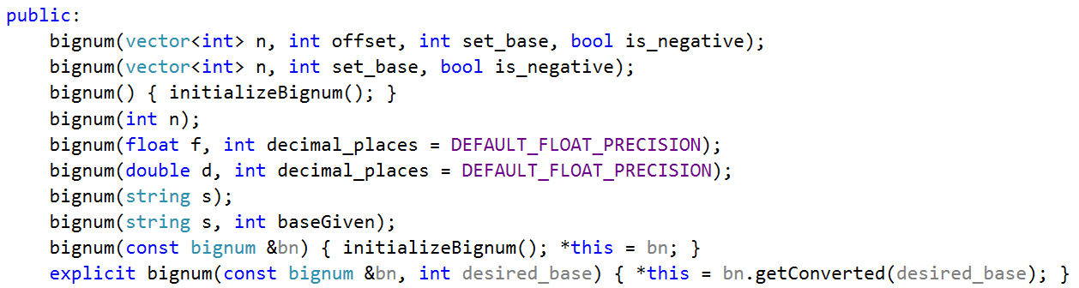

Slide 5
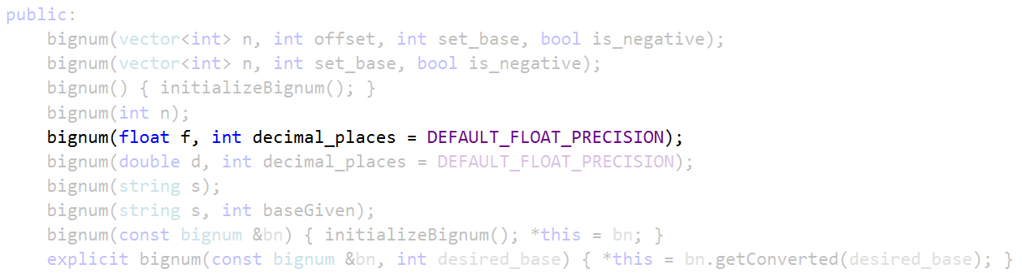

Slide 6

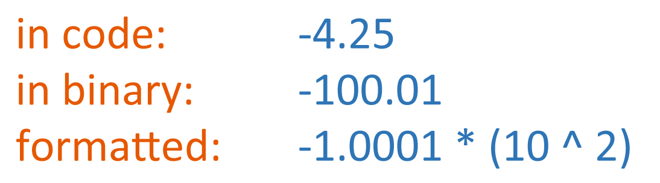

Slide 7
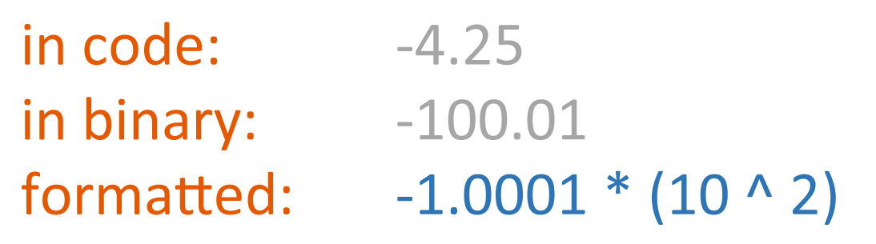

Slide 8
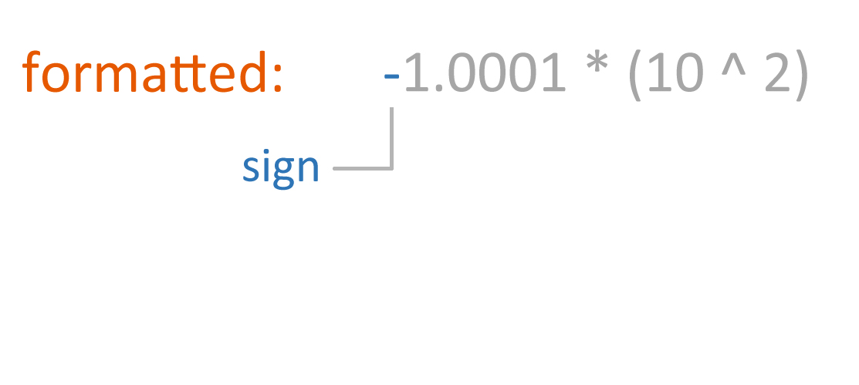

Slide 9
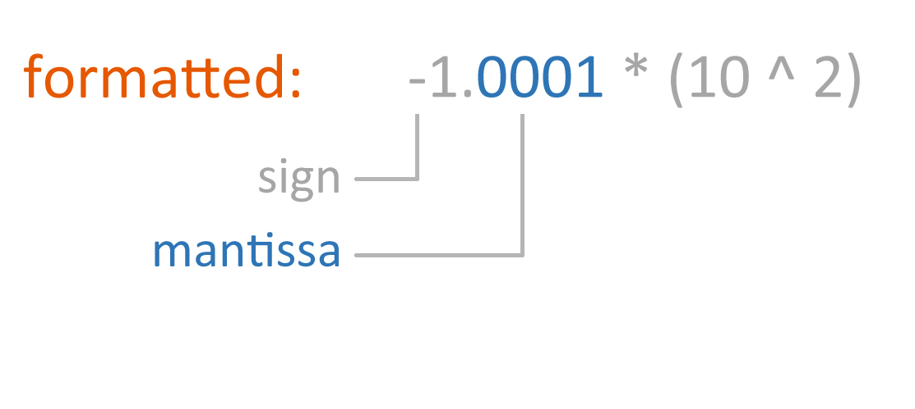

Slide 10
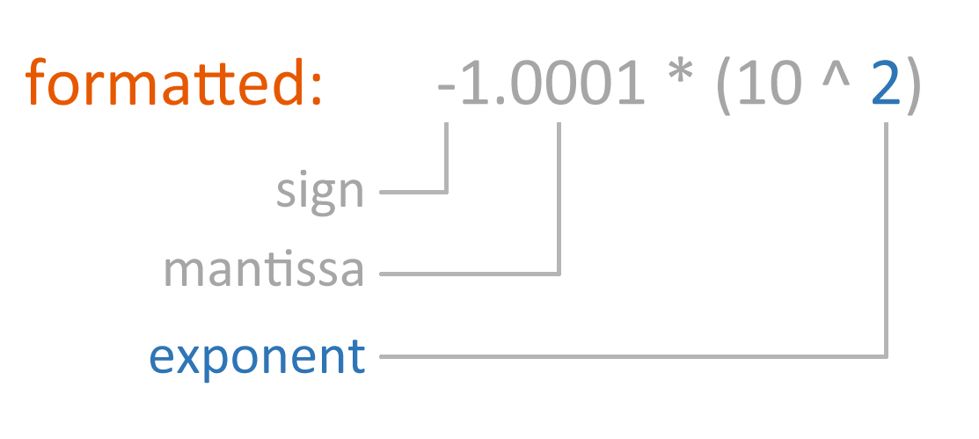

Slide 11
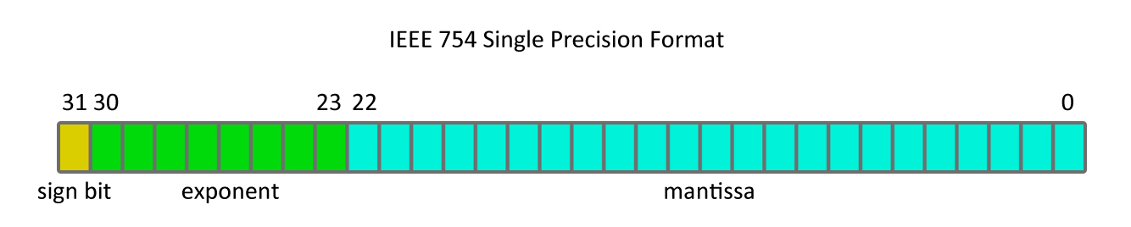
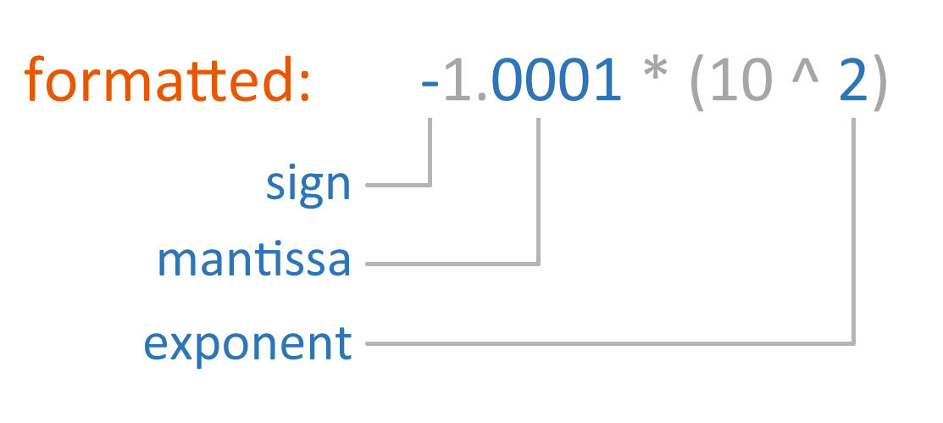

Slide 13

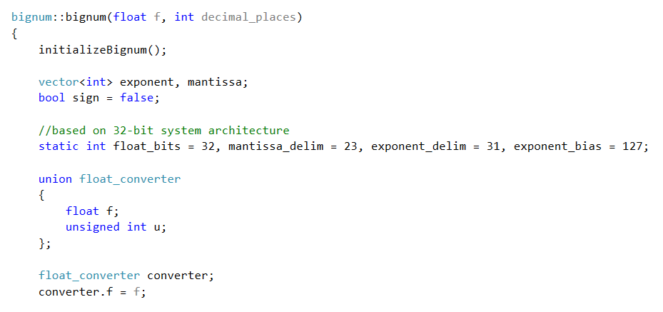

Slide 16
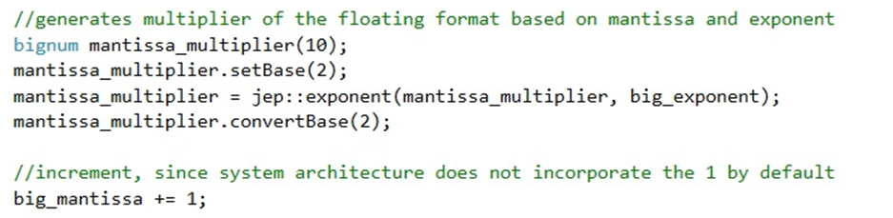
mantissa_multiplier

Slide 17
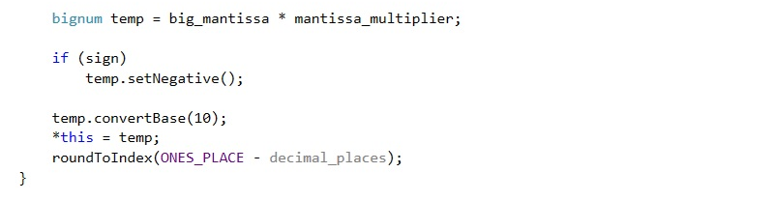

Slide 18
library repo:
github.com/eindacor/JEPbignum
calculator repo:
github.com/eindacor/JEPbignum_calculator
library docs:
github.com/eindacor/JEPbignum/blob/master/README.md

Slide 19
Bignum Calculator
by Joseph Pollack

Slide 20

Bignum Calculator

